Slide 1
Innovating at Scale: Building and Managing A Developer Platform
By Poonam Garg & Carrie Pommier

Slide 2
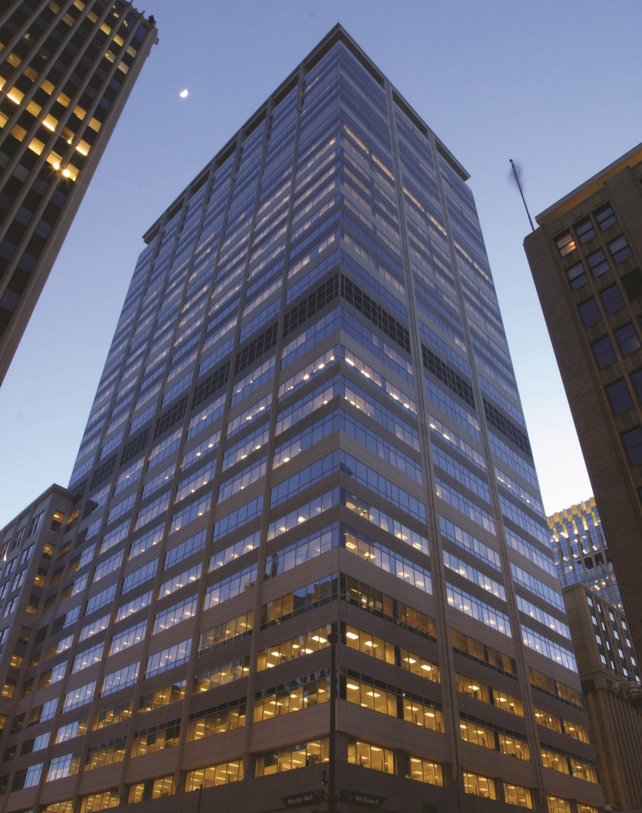
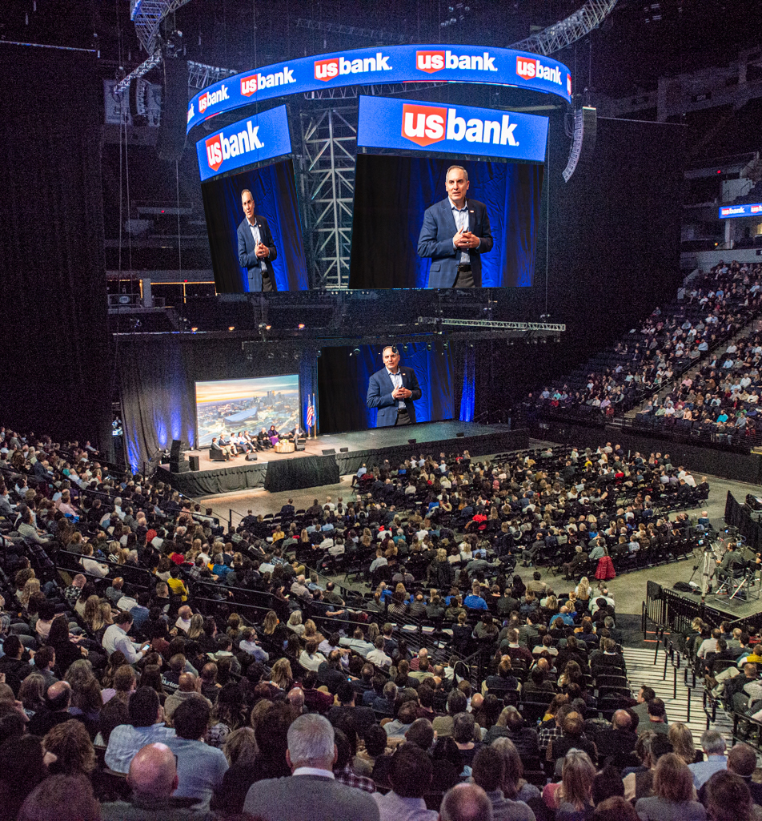
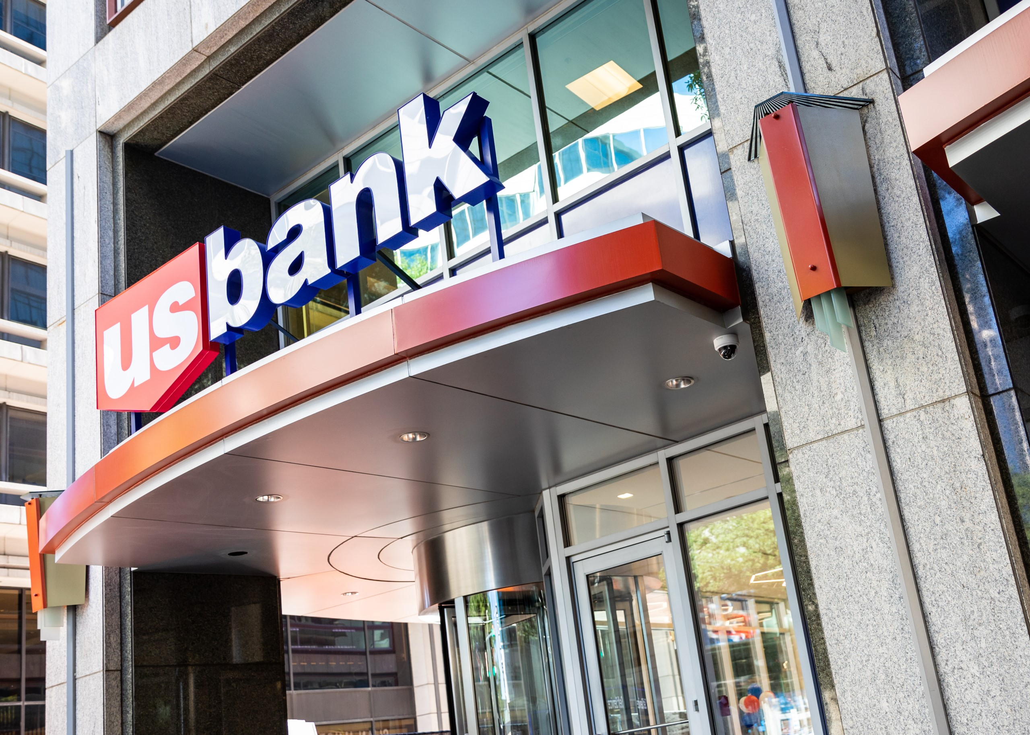
U.S. Bank Intro
Headquartered in Minneapolis, Minnesota
Est. 1863
More than 70,000 team members
Fifth largest commercial bank in U.S.
Notes:
Did you know?
We have employees in 13 countries
We have more than 2,000 branches in 26 states
We’re number 103 on the Fortune 500
U.S. Bancorp is the publicly traded parent company of U.S. Bank. We often use U.S. Bancorp in formal documents and filings, but U.S. Bank is what you’ll see on branch doorways, app stores, national television commercials and more.

Slide 3
Why did we build our own IDP?
Prioritize Developer Productivity
Integrated tools
Enable Business Agility
Build faster
Increase Reliability
Compliant SDLC built in
Developer-First Experience
Persona research
Scaling for the Future
Built to grow with our business needs
Streamlined components
Reduce barrier to entry
Standardization by design
Fail faster
Ship with confidence
Opinionated Pipelines
Proactive monitoring and self-healing as a standard
Reduce cognitive load
Automate tasks
Eliminate dependencies on other teams that frequently create mini-blockers

Slide 4
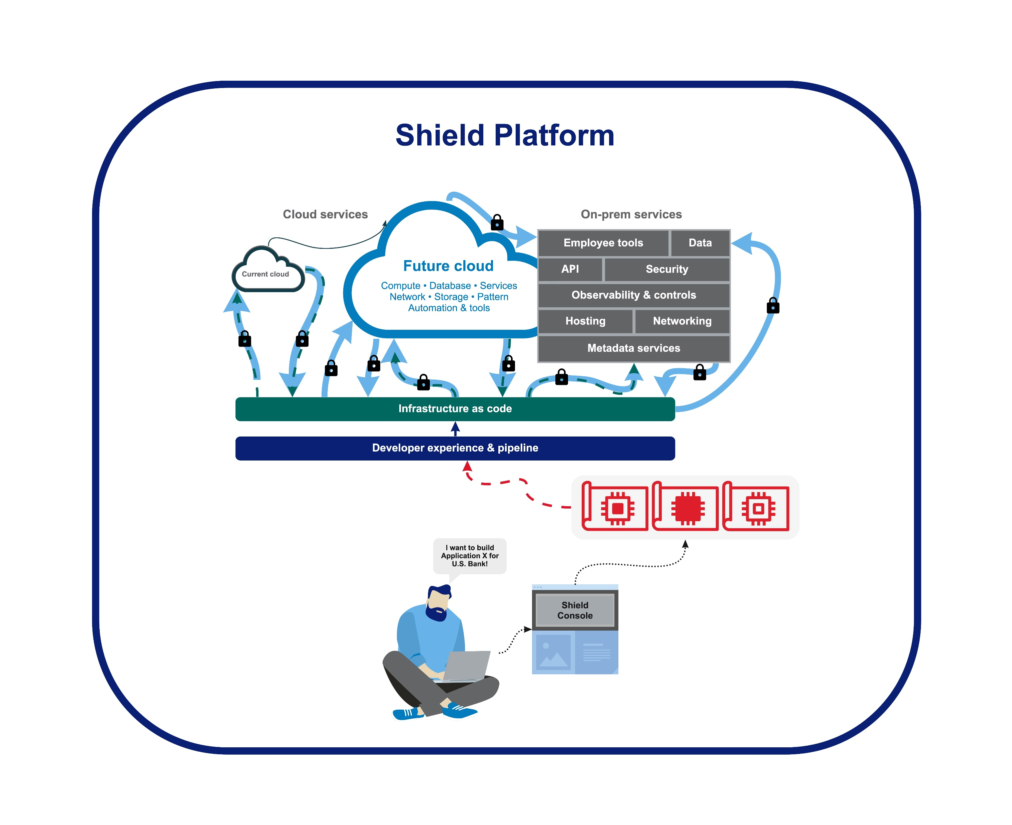

Why Developers Care about The Modern Platform at U.S. Bank
Pipeline Patterns & Templates
Integrated tool with SSO access to what I use in my day
Evidence collection
Single home for documentation
Blueprints – Golden Paths
Single Pane of Glass UI
Controls (inherited & new for Compliance)

Slide 5
Opportunities
Persona driven research
Push the pace iteratively
Transparency
Who are your users and why do they care?
Are there features specific to those personas?
What problems are you hoping to solve for your users by building an IDP?
YOU =/= USER
Early design feedback is key; prototypes are your friend
Be honest about your OODA loop (Observe, Orient, Decide, Act) and critically optimize it
Clarity is kindness
Transformation occurs as a team
Are metrics meaningful metrics to show progress?
Are you SHARING metrics with the right people, even when they aren’t flattering?
Tradeoff Conversations for appy customers.

Slide 6
U.S. Bank logo

